Slide 1



Depi software testing graduation project
Project name: Luma
Group Code: CAI1_SWD7_G3e
Project members
Ahmed Tarek
Hesham Salah
Mariam Milad
Nada Hesham
Nesreen Shata
Rana Rizk
Youssef Ashraf

Slide 2

Table of content:-
Introduction
Manual testing
Test cases done
Automation testing
Test cases done

Slide 3

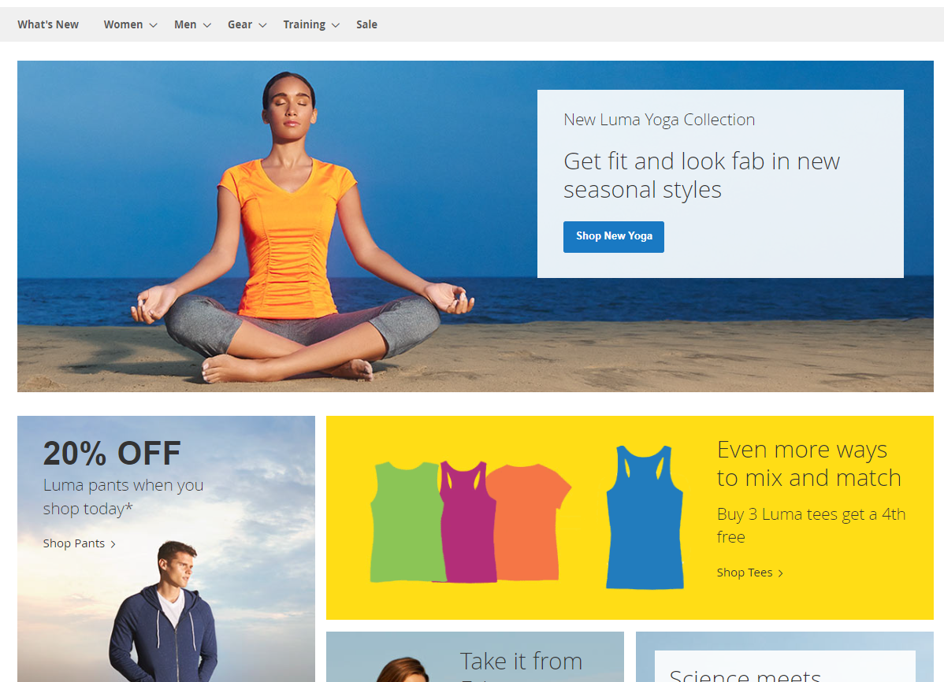
Introduction:-
1- The project is done on software testing board that provides a demo websites to test
2-The website name is Luma
3-The website is for selling clothes
Hoodies & Sweatshirts
Jackets
Tees
Tanks
Pants
Shorts

Slide 4
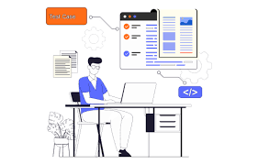
Manual testing:-
Test cases done on the following features :
Sign in
Sign up
Wishlist
Search

Slide 5

Sign in
Expected result:
The user should be signed in successfully and redirected to the dashboard.
Test case ID: TC-SI01
Test case scenario:
Verify the user can sign in with valid credentials
Actual result:
The user signed in successfully and redirected to the dashboard.
Test case:
Log in using a valid Email and password
Test case steps:
1- open chrome browser 2- Enter to "https://magento.softwaretestingboard.com/" url 3-Enter " Laa@gmail.com" in the username field. 4-Enter "Abc@1234" in the password field. Click the "Sign in" button.

Slide 6
Sign in
Expected result:
An error message should appear stating "Invalid username or password.
Test case ID: TC-SI02
Test case scenario:
Verify the system behavior with invalid sign in credentials
Actual result:
An error message is appeared "The account sign-in was incorrect or your account
Test case:
Attempt to sign in with an incorrect username and password.
Test case steps:
1- open chrome browser 2- Enter to "https://magento.softwaretestingboard.com/" url 3-Enter " nesreen@gmail.com" in the username field. 4-Enter "Abc@12345" in the password field. Click the "Sign in" button.

Slide 7
Sign in
Expected result:
Validation messages should appear, indicating that both fields are required.
Test case ID: TC-SI03
Test case scenario:
Verify the system behavior with no sign in data
Actual result:
Validation message is appeared "This is a required field."
Test case:
Attempt to log in without filling in the username and password sections .
Test case steps:
1- open chrome browser 2- Enter to "https://magento.softwaretestingboard.com/" url 3-Leave both the username and password fields empty 4-Click the "Sign in" button.

Slide 8
2. Sign up
Expected result:
The user should be successfully registered, and a confirmation message should be displayed. The user may be automatically logged in or receive a verification email..
Test case ID: TC-SU01
Test case scenario:
Verify that a user can sign up with valid information
Test case:
Sign up using first name , last name a valid email, password, and other required fields
Actual result:
successfully registered and appear this message "Thank you for registering with Main Website Store."
Test case steps:
1- open chrome browser 2- Enter to "https://magento.softwaretestingboard.com/" url 3- Navigate to the sign-up page by clicking on " create an account" 4-Enter a valid first name , last name , email address and password in fields First name : Noha Last Name : Amin Email: noha@gmail.com password:Noha_123 Confirm password: Noha_123 5- then click on " create an account"

Slide 9
2. Sign up
Expected result:
An error message should appear, indicating that the email address is already in use.
Test case ID: TC-SU02
Test case scenario:
Verify the system's response when a user attempts to sign up with an email that is already registered.
Actual result:
This error message is appeared "There is already an account with this email address. If you are sure that it is your email address, click here to get your password and access your account."
Test case:
Try signing up with an existing email address.
Test case steps:
1- open chrome browser 2- Enter to "https://magento.softwaretestingboard.com/" url 3- Navigate to the sign-up page by clicking on " create an account" 4-Enter a valid first name , last name , and enter registered email address before First name : Noha Last Name : Ahmed Email: noha@gmail.com password:Noha_123 Confirm password: Noha_123 5- then click on " create an account"

Slide 10

2. Sign up
Expected result:
The system should display an error message indicating that the first and last name fields should not contain numbers and should accept only alphabetic characters.
Test case ID: TC-SU03
Test case scenario:
Verify the system's response when numbers are entered in the first and last name fields.
Test case:
Attempt to sign up using numbers in the "First Name" and "Last Name" fields.
Actual result:
The system accepted an account and display this successful message "Thank you for registering with Main Website Store"
Test case steps:
1- open chrome browser 2- Enter to "https://magento.softwaretestingboard.com/" url 3- Navigate to the sign-up page by clicking on " create an account" 4-Fill the fields As:- First name : 1 Last Name : 2 Email: noha1@gmail.com password:Noha_1234 Confirm password: Noha_1234 5- then click on " create an account"

Slide 11
2. Sign up
Expected result:
The system should display an error message indicating that the first and last name fields should be like 3 characters
Test case ID: TC-SU04
Test case scenario:
Verify the system's response to minimum character limits for text fields.
Test case:
Attempt to sign up using the minimum number of characters allowed for fields like first name and last name
Actual result:
The system accepted an account and display this successful message "Thank you for registering with Main Website Store"
Test case steps:
1- open chrome browser 2- Enter to "https://magento.softwaretestingboard.com/" url 3- Navigate to the sign-up page by clicking on " create an account" 4-Fill the fields As:- First name : A Last Name : B Email: noha_1@gmail.com password:Noha_1234a Confirm password: Noha_1234 5- then click on " create an account"

Slide 12
3. Wishlist
Expected result:
An appropriate message appears stating, "You must login or register to add items to your Wishlist."
Test case ID: TC-WL001
Test case scenario:
Verify it is not allowed to add to Wishlist Without Signing In
Test case:
Adding a product to the wishlist without being signed in.
Actual result:
The application will view the message as expected"
Test case steps:
1.open chrome browser 2. Open URL "https://magento.softwaretestingboard.com/" 3. Navigate to a product page (Women ->Tops->jackets->juno jacket). 4. Click "Add to Wishlist."

Slide 13
3. Wishlist
Expected result:
The product is added to the Wishlist, and a success message is displayed "Juno Jacket has been added to your Wish List. Click here to continue shopping.", items counter increment
Test case ID: TC-WL002
Test case scenario:
Verify Adding functionality to Wishlist
Actual result:
The product will be added and the message appears as expected, items counter increment
Test case:
Adding a Product to Wishlist after signing in
Test case steps:
1.open chrome browser 2. Open URL "https://magento.softwaretestingboard.com/" 3. Sign in to the account. 4. Note the initail Wish List count 5. Navigate to a product page not in your wish list (Women ->Tops->jackets->juno jacket) 6. Click "Add to Wishlist." 7. Note the updated wish list items count

Slide 14
3. Wishlist
Expected result:
The product is removed from the wishlist, and a success message is displayed "Juno Jacket has been removed from your Wish List."
Test case ID: TC-WL003
Test case scenario:
Verify Removing a Product from Wishlist
Actual result:
The product will be removed and the message appears as expected
Test case:
Removing a product by navigating to the Wishlist tab and using the rubbish icon.
Test case steps:
1.open chrome browser 2. Open URL "https://magento.softwaretestingboard.com/" 3. Sign in to the account. 4.Navigate to a product page (Women ->Tops->jackets->juno jacket) 5. Click "Add to Wishlist." 6. click on "Go to wish list" button 7. Stand with the mouse on the product "juno jacket" 8. Click on the rubbish icon

Slide 15
3. Wishlist
Expected result:
The product is removed from the wishlist, and a success message is displayed "Juno Jacket has been removed from your Wish List." and items counter in wishlist decrement.
Test case ID: TC-WL004
Test case scenario:
Verify Removing a Product from Wishlist
Actual result:
The product will be removed and the message appears as expected
Test case:
Removing a product directly from "My wish List" using the "X" icon.
Test case steps:
1.open chrome browser 2. Open URL "https://magento.softwaretestingboard.com/" 3. Sign in to the account. 4.Navigate to a product page (Women ->Tops->jackets->juno jacket) 5. Click "Add to Wishlist." 6. Go to "My Wish List" at the bottom on the left of the page 7. Stand with the mousthe product "juno jacket" 8. Click on the "X" icon

Slide 16
3. Wishlist
Expected result:
a message stating that the item is already in your wish list appears . the counter of items is fixed (doesn't increment)
Test case ID: TC-WL005
Test case scenario:
Verify Wishlist Count doesn't Update in incrementing the same product more than once
Actual result:
a success message is displayed instead of the statement that: this item is already in your wishlist
Test case:
Adding a product that was added before to the wishlist.
Test case steps:
1.open chrome browser 2. Open URL "https://magento.softwaretestingboard.com/" 3. Sign in to the account. 4. Note the initail Wish List count 5. Navigate to a product page not in your wish list (Women ->Tops->jackets->juno jacket) 6. Click "Add to Wishlist." 7. Note the updated wicsh list count 8. Navigate to the same product page 9. Click "Add to Wishlist." 10. Note the updated wicsh list items count

Slide 17
4. Search
Expected result:
the application will accept any alphabets, numbers or symbols
Test case ID: TC-SR01
Test case scenario:
Verifying the Search Functionality
Actual result:
the user is able to enter any alphabets, numbers or symbols
Test case:
Verify that search field accepts alphabets, numbers or symbols.
Test case steps:
1.open chrome browser
2. Open URL https://magento.softwaretestingboard.com/
3. Click on Search place holder filed
4. Type any alphabets, numbers or symbols"

Slide 18
4. Search
Expected result:
the application will perform the search on "Hero Hoodie" and navigate to search result page
Test case ID: TC-SR02
Test case scenario:
Verifying the Search Functionality
Actual result:
the application perform the search as expected
Test case:
Verify that after entering search text and clicking on search icon, the search should be performed.
Test case steps:
1.open chrome browser 2. Open URL https://magento.softwaretestingboard.com/ 3. Click on Search place holder filed 4. search on "Hero Hoodie" 5. Browser will navigate to search result page and show the searched icon

Slide 19
4. Search
Expected result:
the search query should be same as the name of the product searched
Test case ID: TC-SR03
Test case scenario:
Verifying the Search Functionality
Actual result:
the search query result same as the entered value
Test case:
Verify that the search results should be as per the search query.
Test case steps:
1.open chrome browser 2. Open URL https://magento.softwaretestingboard.com/ 3. Click on Search place holder filed 4. search on "Hero Hoodie"

Slide 20
4. Search
Expected result:
the application will perform the search on different categories
Test case ID: TC-SR04
Test case scenario:
Verifying the Search Functionality
Actual result:
the application perform the search as expected
Test case:
Verify that user should be perform search in different categories for example, women, men, gear,..etc.
Test case steps: 1.open chrome browser 2. Open URL "https://magento.softwaretestingboard.com/" 3. Click on Search place holder filed 4. search on "Gear" categorie

Slide 21
4. Search
Expected result:
application should have filter option on result page
Test case ID: TC-SR05
Test case scenario:
Verifying the Search Functionality
Actual result:
filter option doesn't exist
Test case:
Verify that filter should be present for filtering the search results bases on Brand, Price, Reviews, Ratings ,gender ,...etc
Test case steps: 1.open chrome browser 2. Open URL "https://magento.softwaretestingboard.com/" 3. Click on Search place holder filed 4. search on "Hero Hoodie" 5. Browser will navigate to search result page 6. choose the filtering option

Slide 22
4. Search
Expected result:
application should have sorting option on result page and user could sort by price
Test case ID: TC-SR06
Test case scenario:
Verifying the Search Functionality
Actual result:
the application perform the sorting by price as expected
Test case:
Verify that sorting options should be present on search results page.
Test case steps: 1.open chrome browser 2. Open URL https://magento.softwaretestingboard.com/ 3. Click on Search place holder filed 4. search on "Hero Hoodie" 5. press on sort by and choose the sort by "price"

Slide 23
4. Search
Expected result:
application showed the number of searched result
Test case ID: TC-SR07
Test case scenario:
Verifying the Search Functionality
Actual result:
application performed as expected
Test case:
Verify that the number of search results displayed on one page.
Test case steps: 1.open chrome browser 2. Open URL https://magento.softwaretestingboard.com/ 3. Click on Search place holder filed 4. search on "Hero Hoodie" 5. Browser will navigate to search result page 6. check number of search results displayed on one page.

Slide 24
4. Search
Expected result:
application showed navigation for pages
Test case ID: TC-SR08
Test case scenario:
Verifying the Search Functionality
Actual result:
application performed as expected
Test case:
Verify that there should be navigation button(Next and Previous) for navigation to pages.
Test case steps: 1.open chrome browser 2. Open URL https://magento.softwaretestingboard.com/ 3. Click on Search place holder filed 4. search on "Hero Hoodie" 5. Browser will navigate to search result page 6. check navigation button(Next and Previous) for pages.

Slide 25
4. Search
Expected result:
user should write "For" and the application will show " Formal pants " on search quarry result
Test case ID: TC-SR09
Test case scenario:
Verifying the Search Functionality
Actual result:
application performed as expected
Test case:
Verify that Partial Match Search for a product or category will show the relevant product or category
Test case steps: 1.open chrome browser 2. Open URL https://magento.softwaretestingboard.com/ 3. Click on Search place holder filed 4. write "For" to search on "formal pants" in Search filed.

Slide 26
4. Search
Expected result:
the application will show "Your search returned no results" on search result page.
Test case ID: TC-SR10
Test case scenario:
Verifying the Search Functionality
Actual result:
the application showed the expected massage
Test case:
verify that the search results do not include irrelevant or outdated products.
Test case steps: 1.open chrome browser 2. Open URL https://magento.softwaretestingboard.com/ 3. Click on Search place holder filed 4. search on "baloan" 5. Browser will navigate to search result page

Slide 27
4. Search
Expected result:
the application will perform the search on "Hero Hoodie" and navigate to search result page
Test case ID: TC-SR11
Test case scenario:
Verifying the Search Functionality
Actual result:
the application perform the search as expected
Test case:
verify search functionality on different devices and browsers to ensure compatibility
Test case steps: 1.use mobile device
2.open ""Edge"" browser
3.OpenURL https://magento.softwaretestingboard.com/
4. Click on Search place holder filed
5. search on "Hero Hoodie"
6. Browser will navigate to search result page and show the searched icon"

Slide 28
Automation testing:-
Test cases done utilizing Selenium for browser automation, TestNG for test management, Maven for build automation, and the Page Object Model for code organization and maintainability
on the following features:
Sign in
Sign up
Search
Add to cart

Slide 29
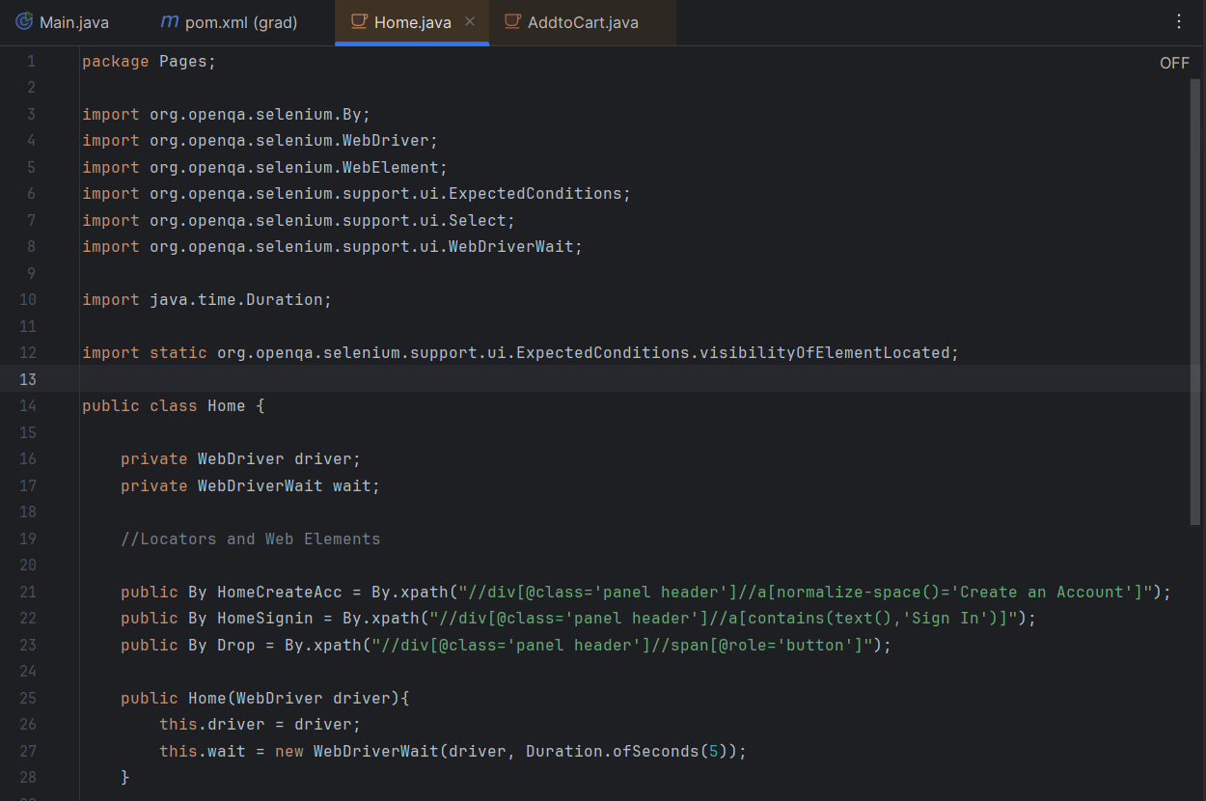
1- Sign in

Slide 30
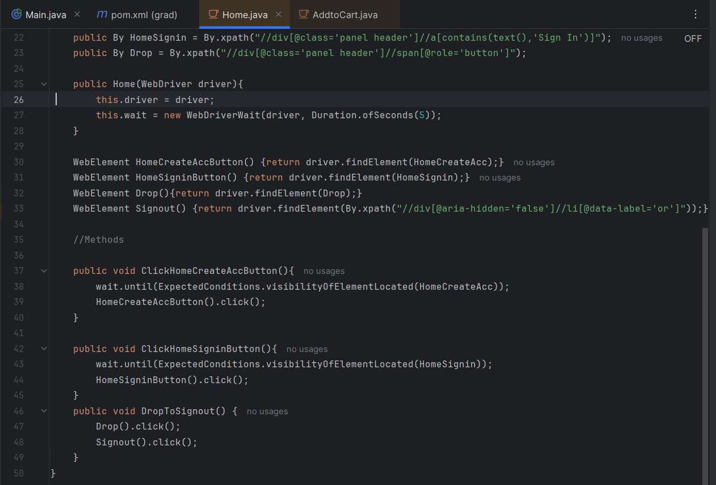
1- Sign in

Slide 31
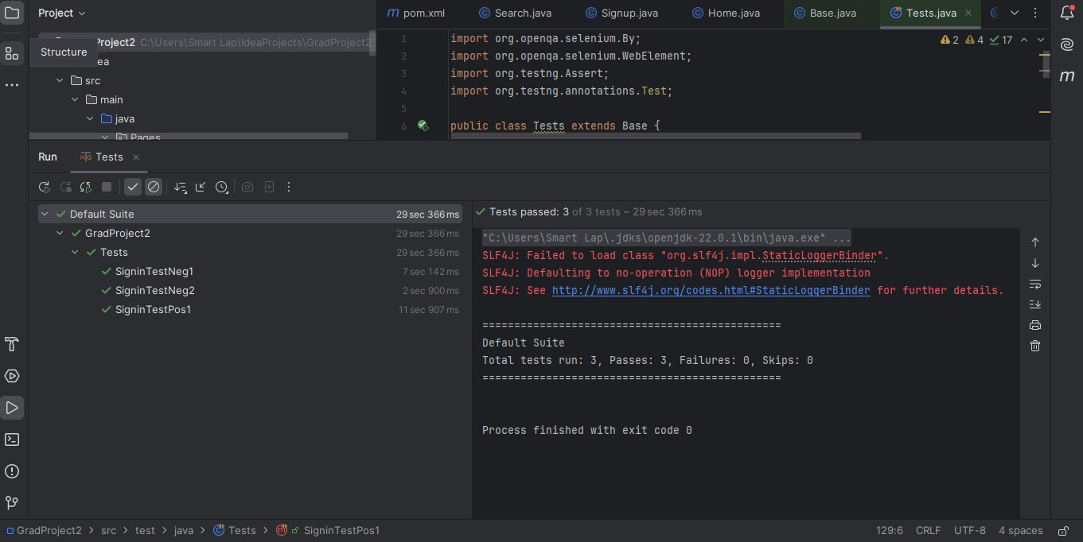
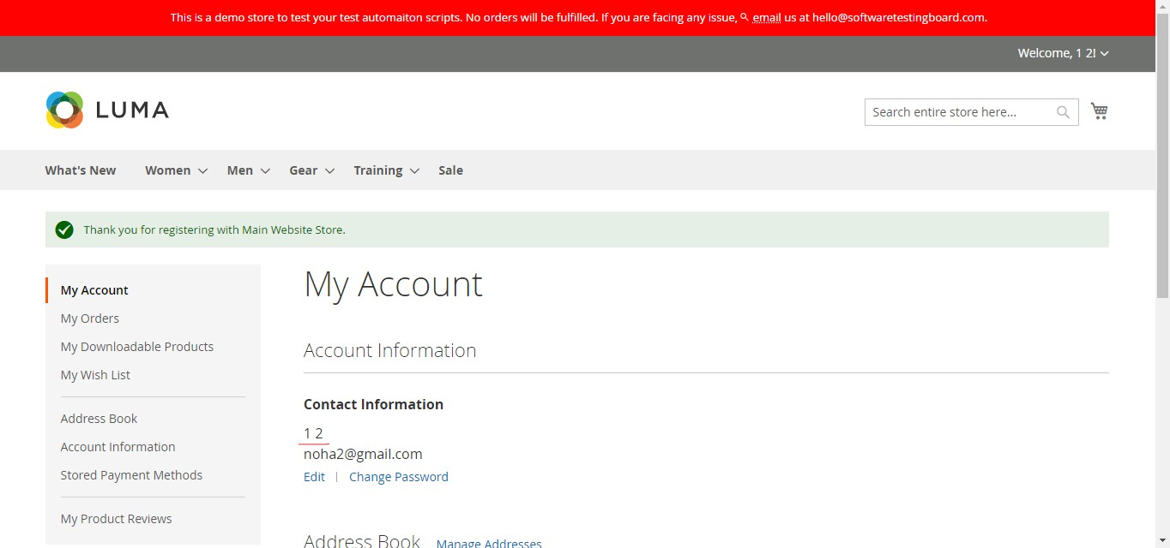
1- Sign in results

Slide 32
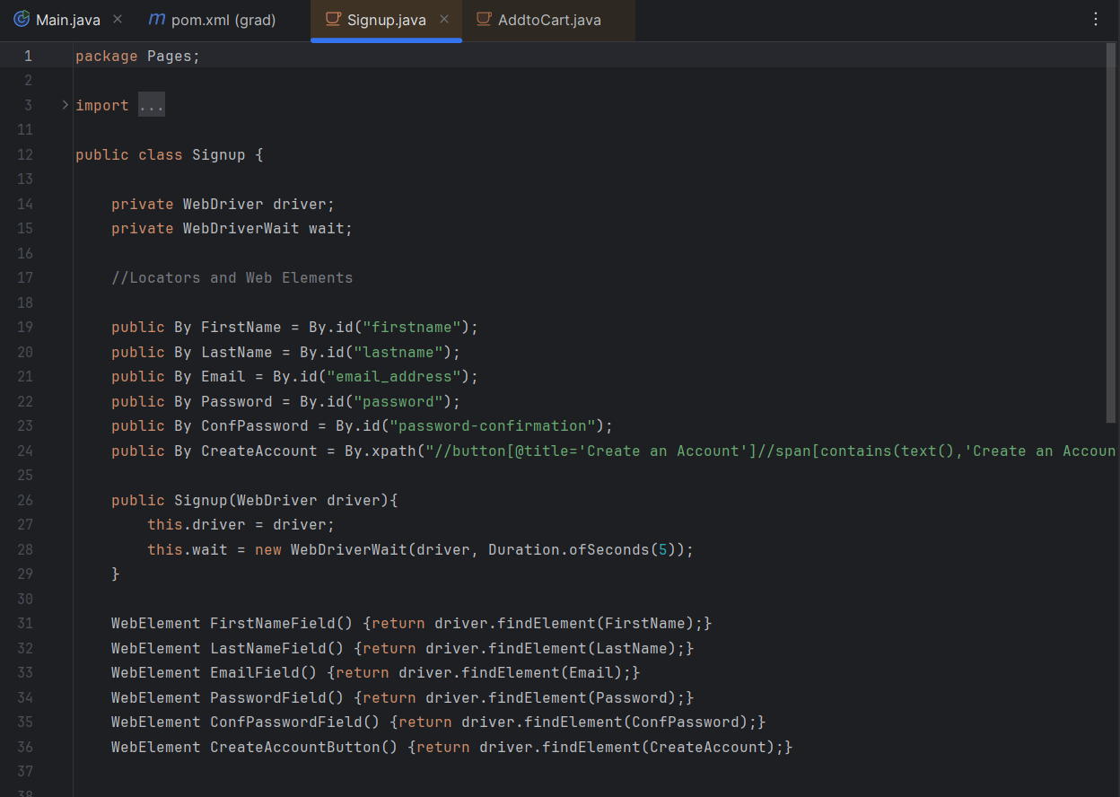
2- Sign up

Slide 33
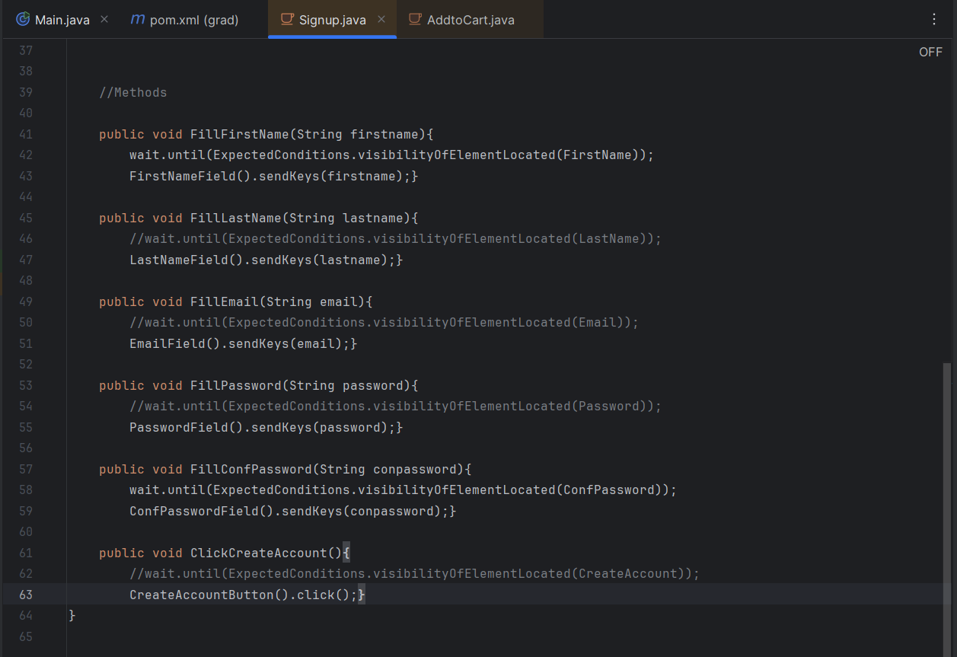
2- Sign up

Slide 34
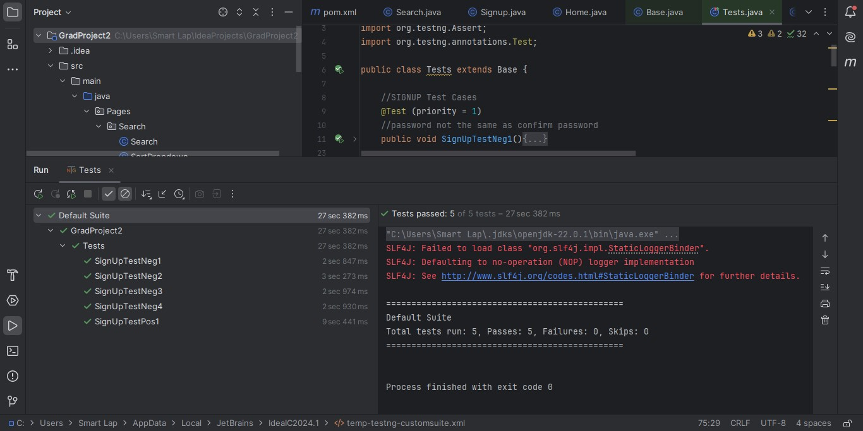
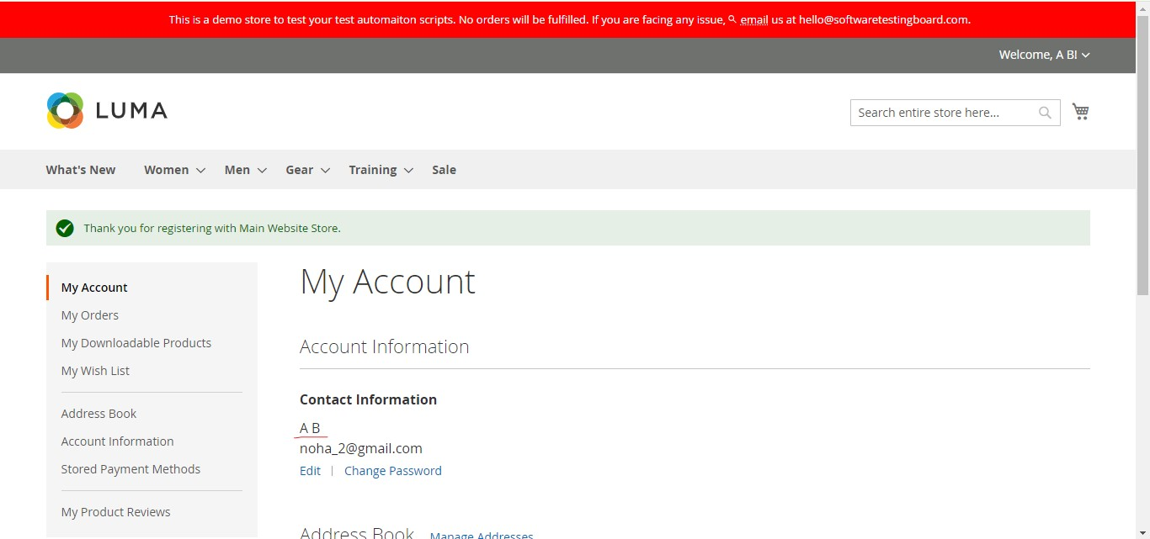
2- Sign up results

Slide 35
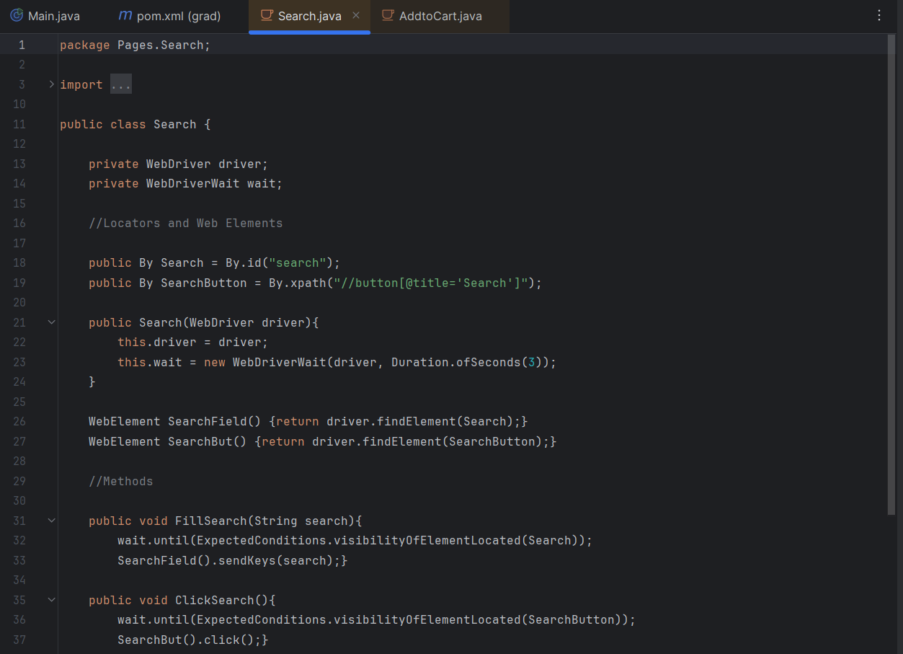
3- Search

Slide 36
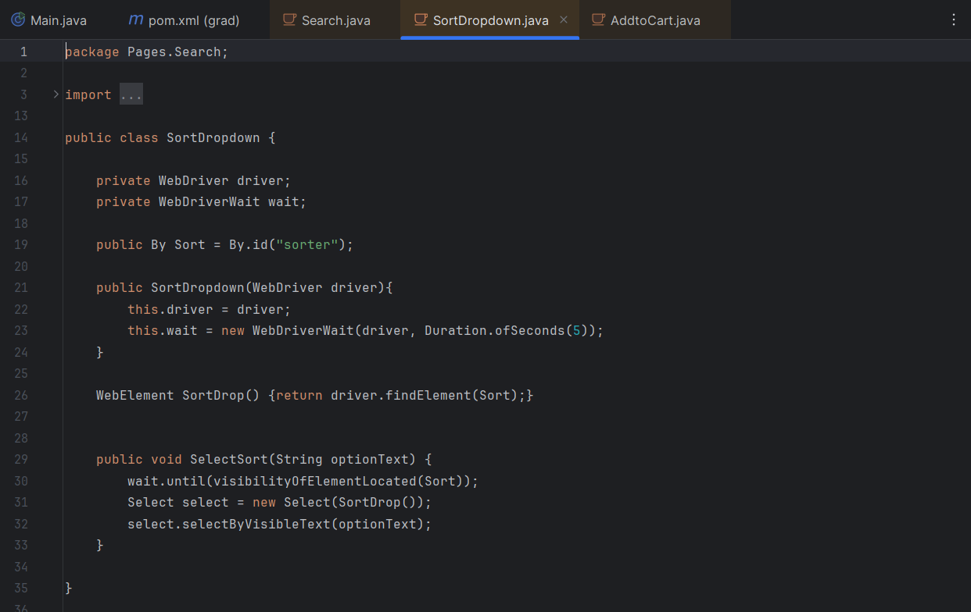
3- Search sort down

Slide 37
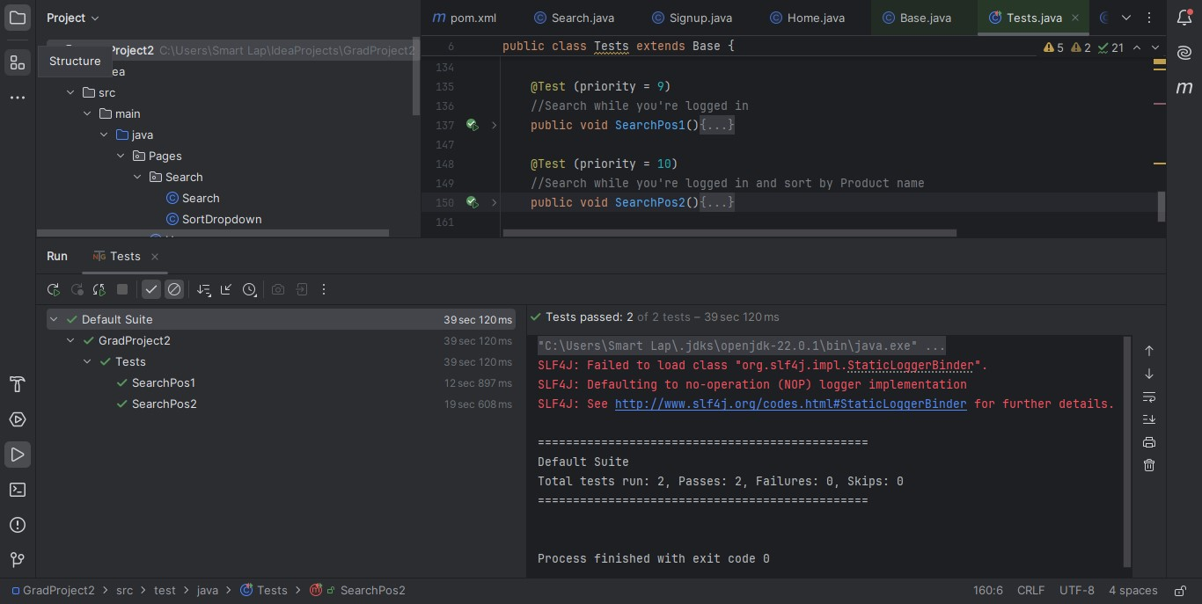
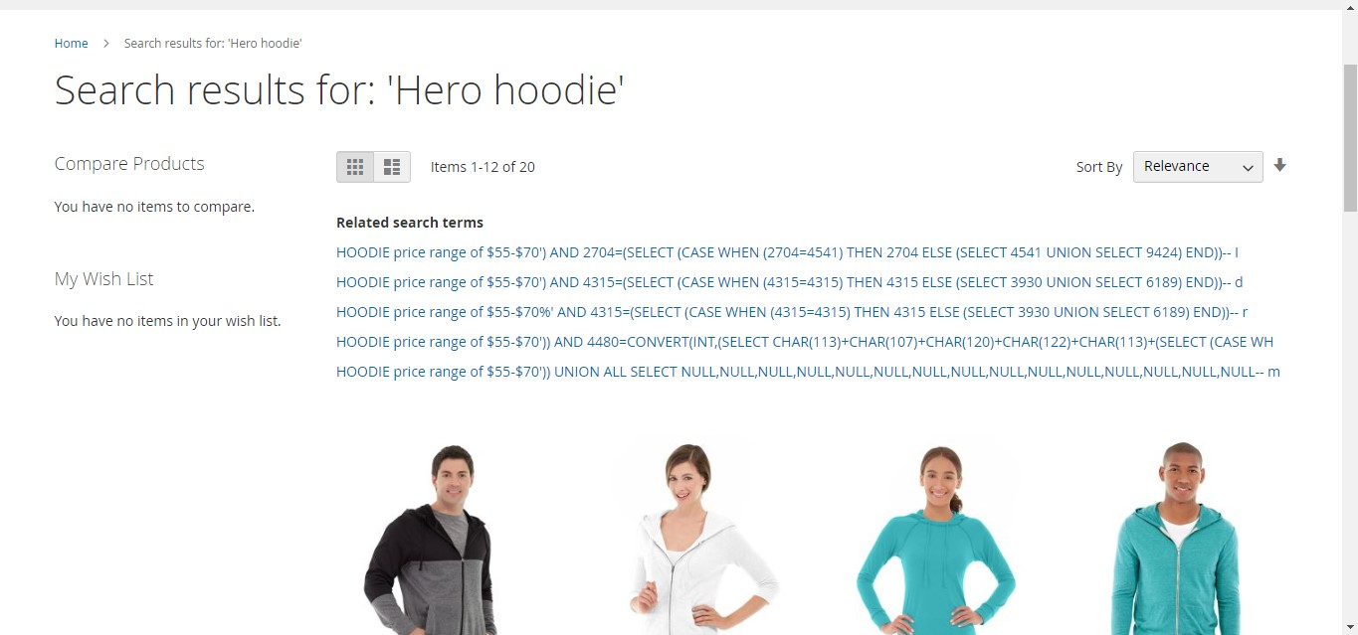
3- Search results

Slide 38
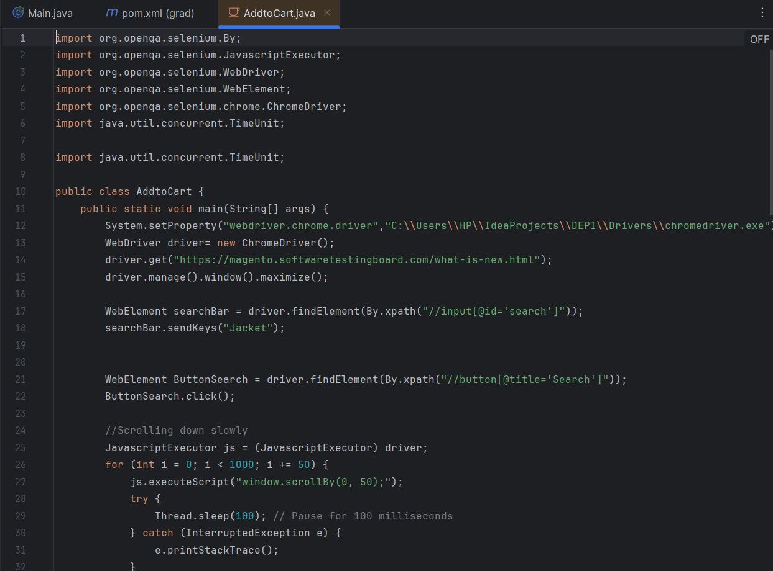
4- Add To Cart

Slide 39
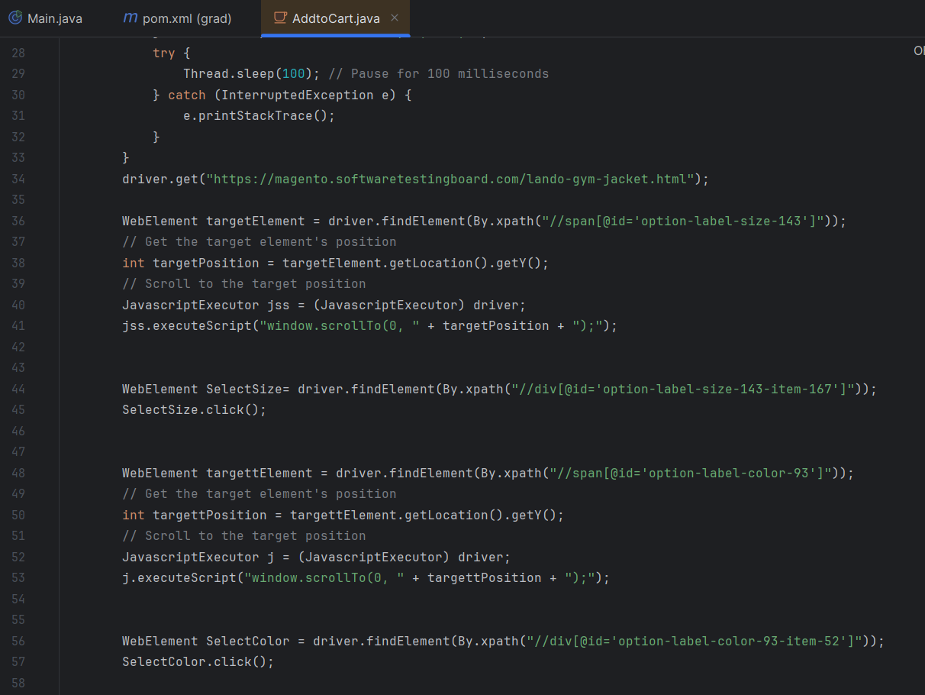
4- Add To Cart

Slide 40
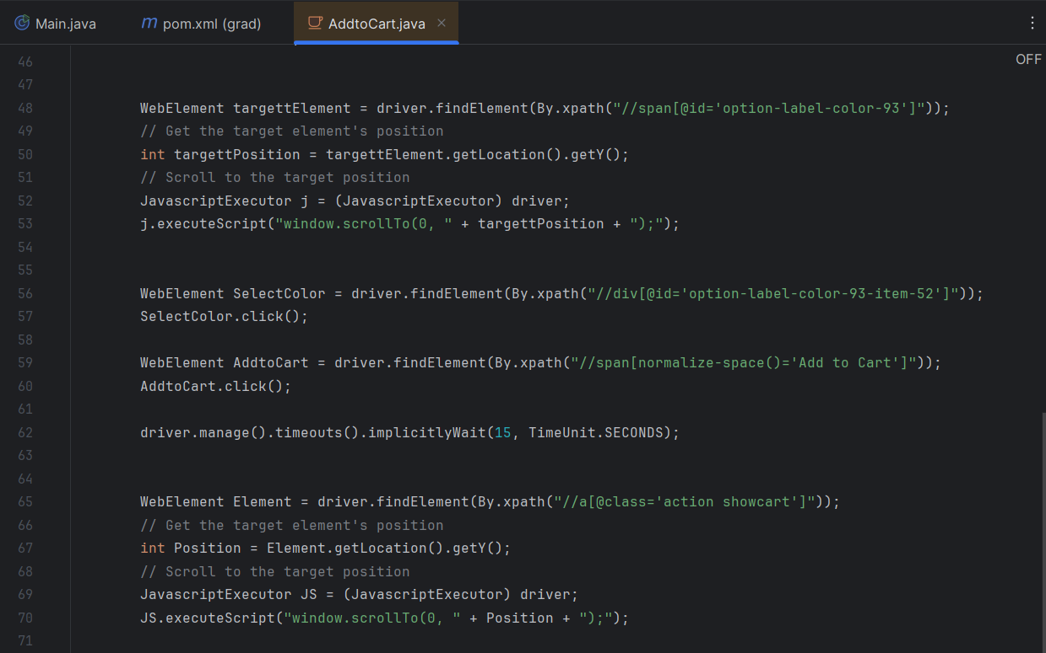
4- Add To Cart

Slide 41
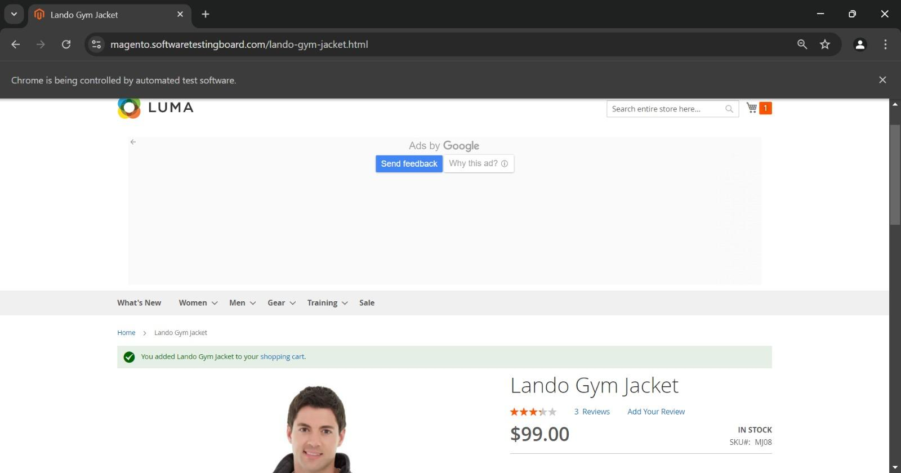
4- Add To Cart results

Slide 42

THANK YOU

